Slide 1
POINTERS
A pointer is a variable that is used to stores the memory address of another variable

Slide 2
INTRODUCTION
A pointer is a derived data type in C.
Pointers contain memory addresses as their values.
Since these memory addresses are the locations in the computer memory where program instructions and data are stored, pointers can be used to access and manipulate data stored in the memory.

Slide 3
UNDERSTANDING POINTERS
The computer’s memory is a sequential collection of storage cells. Each cell, commonly known as a byte, has a number called address associated with it.
Typically, the addresses are numbered consecutively, starting from zero. The last address depends on the memory size.
A computer system having 64 K memory will have its last address as 65,535.

Slide 4
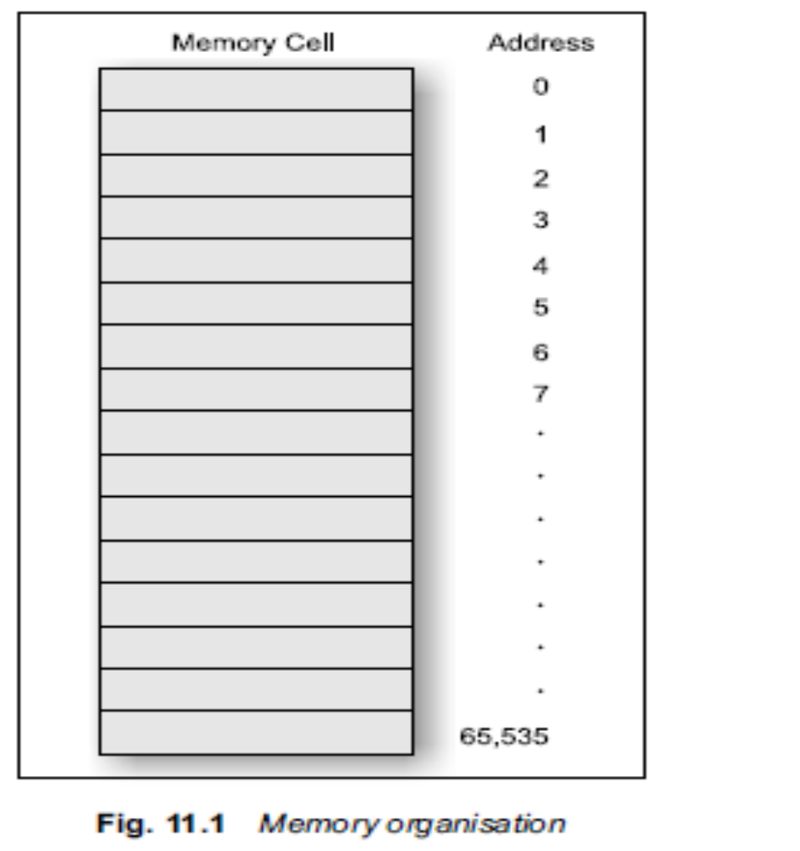

Slide 5
Whenever we declare a variable, the system allocates, somewhere in the memory, an appropriate location to hold the value of the variable. Since, every byte has a unique address number, this location will have its own address number. Consider the following statement
int quantity = 179;
This statement instructs the system to find a location for the integer variable quantity and puts the value 179 in that location.

Slide 6
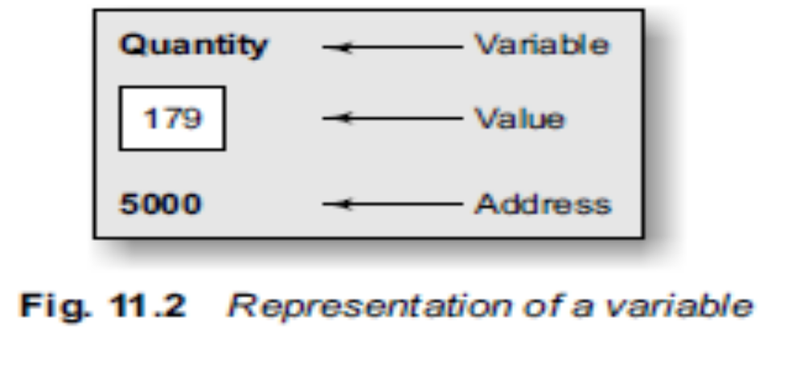
Let us assume that the system has chosen the address location 5000 for quantity.
We may represent this as shown in Fig. 11.2. (Note that the address of a variable is the address of the first bye occupied by that variable.)
During execution of the program, the system always associates the name quantity with the address 5000. (This is something similar to having a house number as well as a house name.) We may have access to the value 179 by using either the name quantity or the address 5000.

Slide 7
Since memory addresses are simply numbers, they can be assigned to some variables, that can be stored in memory, like any other variable.
Such variables that hold memory addresses are called pointer variables.
A pointer variable is, therefore, nothing but a variable that contains an address, which is a location of another variable in memory.

Slide 8
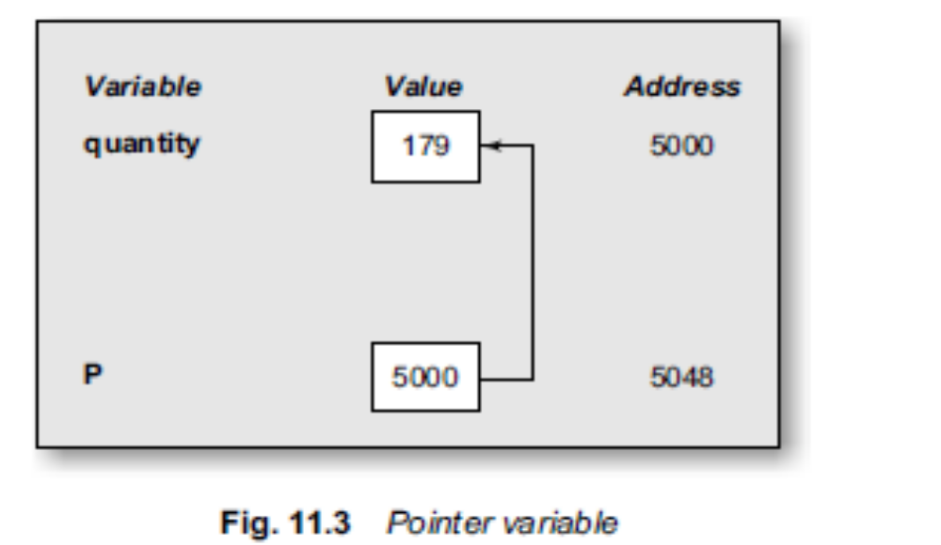
since a pointer is a variable, its value is also stored in the memory in another location. Suppose, we assign the address of quantity to a variable p. The link between the variables p and quantity can be visualized as shown in Fig.11.3.
The address of p is 5048.
Since the value of the variable p is the address of the variable quantity, we may access the value of quantity by using the value of p and therefore, we say that the variable p ‘points’ to the variable quantity. Thus, p gets the name ‘pointer’.

Slide 9
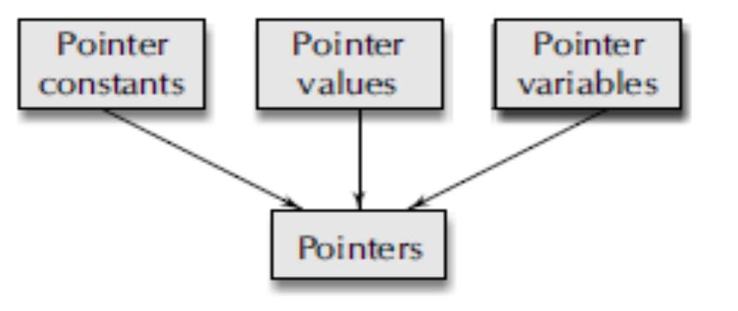
Pointers are built on the three underlying concepts:
Memory addresses within a computer are referred to as pointer constants. We cannot change them; we can only use them to store data values. They are like house numbers.
We cannot save the value of a memory address directly. We can only obtain the value through the variable stored there using the address operator (&). The value thus obtained is known as pointer value.
The pointer value (i.e. the address of a variable) may change from one run of the program to another.
Once we have a pointer value, it can be stored into another variable. The variable that contains a
pointer value is called a pointer variable.

Slide 10
ACCESSING THE ADDRESS OF A VARIABLE
The actual location of a variable in the memory is system dependent and therefore, the address of a variable is not known to us immediately.
How can we then determine the address of a variable?
This can be done with the help of the operator & available in C.
We have already seen the use of this address operator in the scanf function. The operator & immediately preceding a variable returns the address of the variable associated with it. For example, the statement
p = &quantity;
would assign the address 5000 (the location of quantity) to the variable p. The & operator can be remembered as ‘address of ’.

Slide 11
The & operator can be used only with a simple variable or an array element. The following are illegal use of address operator:
1. &125 (pointing at constants).
2. int x[10];
&x (pointing at array names).
3. &(x+y) (pointing at expressions).
If x is an array, then expressions such as
&x[0] and &x[i+3]
are valid and represent the addresses of 0th and (i+3)th elements of x.

Slide 12
Write a program to print the address of a variable along with its value
Void main()
{
char a;
int x;
float p, q;
a = ‘A’;
x = 125;
p = 10.25, q = 18.76;
printf(“%c is stored at addr %u.\n”, a, &a);
printf(“%d is stored at addr %u.\n”, x, &x);
printf(“%f is stored at addr %u.\n”, p, &p);
printf(“%f is stored at addr %u.\n”, q, &q);
}
Output
A is stored at addr 4436.
125 is stored at addr 4434.
10.250000 is stored at addr 4442.
18.760000 is stored at addr 4438.

Slide 13
DECLARING POINTER VARIABLES
In C, every variable must be declared for its type. Since pointer variables contain addresses that belong to a separate data type, they must be declared as pointers before we use them. The declaration of a pointer variable takes the following form:
data_type *pt_name;
This tells the compiler three things about the variable pt_name.
1. The asterisk (*) tells that the variable pt_name is a pointer variable.
2. pt_name needs a memory location.
3. pt_name points to a variable of type data_type.

Slide 14

For example,
int *p; /* integer pointer */
declares the variable p as a pointer variable that points to an integer data type.
Similarly, the statement
float *x; / * float pointer */
declares x as a pointer to a floating-point variable.
The declarations cause the compiler to allocate memory locations for the pointer variables p and
x. Since the memory locations have not been assigned any values, these locations may contain some unknown values in them and therefore they point to unknown locations as shown:
int *p;

Slide 15
pointer Declaration style
Pointer variables are declared similarly as normal variables except for the addition of the unary * operator.
This symbol can appear anywhere between the type name and the printer variable name. Programmers
use the following styles:
int* p; /* style 1 */
int *p; /* style 2 */
int * p ; /* style 3 */

Slide 16
However, the style 2 is becoming increasingly popular due to the following reasons:
1. This style is convenient to have multiple declarations in the same statement. Example: int *p, x, *q;
2. This style matches with the format used for accessing the target values. Example:
int x, *p, y;
x = 10;
p = & x;
y = *p; /* accessing x through p */
*p = 20; /* assigning 20 to x */
We use: int *p;

Slide 17
INITIALIZATION OF POINTER VARIABLES
The process of assigning the address of a variable to a pointer variable is known as initialization. As pointed out earlier, all uninitialized pointers will have some unknown values that will be interpreted as memory addresses. They may not be valid addresses or they may point to some values that are wrong. Since the compilers do not detect these errors, the programs with uninitialized pointers will produce erroneous results. It is therefore important to initialize pointer variables carefully before they are used in the program.
Once a pointer variable has been declared we can use the assignment operator to initialize the
variable. Example:
int quantity;
int *p; /* declaration */
p = &quantity; /* initialization */

Slide 18
We can also combine the initialization with the declaration. That is,
int *p = &quantity;
is allowed. The only requirement here is that the variable quantity must be declared before the
initialization takes place. Remember, this is an initialization of p and not *p.
We must ensure that the pointer variables always point to the corresponding type of data. For
example,
float a, b;
int x, *p;
p = &a; /* wrong */
b = *p;
will result in erroneous output because we are trying to assign the address of a float variable to an
integer pointer.

Slide 19
When we declare a pointer to be of int type, the system assumes that any address that the pointer will hold will point to an integer variable. Since the compiler will not detect such errors, care
should be taken to avoid wrong pointer assignments.
It is also possible to combine the declaration of data variable, the declaration of pointer variable and the initialization of the pointer variable in one step. For example,
int x, *p = &x; /* three in one */
is perfectly valid. It declares x as an integer variable and p as a pointer variable and then initializes p to the address of x. And also remember that the target variable x is declared first. The statement
int *p = &x, x;
is not valid.
We could also define a pointer variable with an initial value of NULL or 0 (zero). That is, the following statements are valued
int *p = NULL;
int *p = 0;

Slide 20
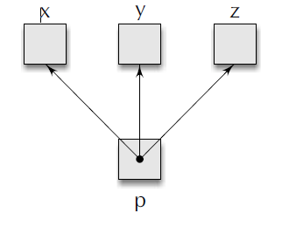
Pointer Flexibility
Pointers are flexible. We can make the same pointer to point to different data variables in different statements. Example;
int x, y, z, *p;
. . . . .
p = &x;
. . . . .
p = &y;
. . . . .
p = &z;
. . . . .

Slide 21

We can also use different pointers to point to the same data variable. Example;
int x;
int *p1 = &x;
int *p2 = &x;
int *p3 = &x;
. . . . .
. . . . .
With the exception of NULL and 0, no other constant value can be assigned to a pointer variable. For
example, the following is wrong:
int *p = 5360; / *absolute address */

Slide 22
ACCESSING A VARIABLE THROUGH ITS POINTER
Once a pointer has been assigned the address of a variable, the question remains as to how to access the value of the variable using the pointer? This is done by using another unary operator * (asterisk), usually known as the indirection operator.
Another name for the indirection operator is the dereferencing operator. Consider the following statements:
int quantity, *p, n;
quantity = 179;
p = &quantity;
n = *p;

Slide 23
The first line declares quantity and n as integer variables and p as a pointer variable pointing to an
integer. The second line assigns the value 179 to quantity and the third line assigns the address of
quantity to the pointer variable p. The fourth line contains the indirection operator *. When the operator * is placed before a pointer variable in an expression (on the right-hand side of the equal sign), the pointer returns the value of the variable of which the pointer value is the address. In this case, *p returns the value of the variable quantity, because p is the address of quantity. The * can be remembered as ‘value at address’. Thus, the value of n would be 179. The two statements
p = &quantity;
n = *p;
are equivalent to
n = *&quantity;
which in turn is equivalent to
n = quantity;

Slide 24
In C, the assignment of pointers and addresses is always done symbolically, by means of symbolic names. You cannot access the value stored at the address 5368 by writing *5368. It will not work.
Below Program illustrates the distinction between pointer value and the value it points to.
The program clearly shows how we can access the value of a variable using a pointer.

Slide 25
Program
main( )
{
int x, y;
int *ptr;
x = 10;
ptr = &x;
y = *ptr;
printf(“Value of x is %d\n\n”,x);
printf(“%d is stored at addr %u\n”, x, &x);
printf(“%d is stored at addr %u\n”, *&x, &x);
printf(“%d is stored at addr %u\n”, *ptr, ptr);
printf(“%d is stored at addr %u\n”, ptr, &ptr);
printf(“%d is stored at addr %u\n”, y, &y);
*ptr = 25;
printf(“\nNow x = %d\n”,x);
}
Output
Value of x is 10
10 is stored at addr 4104
10 is stored at addr 4104
10 is stored at addr 4104
4104 is stored at addr 4106
10 is stored at addr 4108
Now x = 25
Program to Access a variable through its pointer

Slide 26
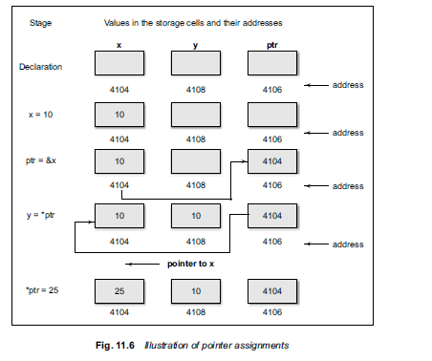
The actions performed by the program is illustrated below. The statement ptr = &x assigns the address of x to ptr and y = *ptr assigns the value pointed to by the pointer ptr to y.

Slide 27

CHAIN OF POINTERS
It is possible to make a pointer to point to another pointer, thus creating a chain of pointers as shown.
Here, the pointer variable p2 contains the address of the pointer variable p1, which points to the
location that contains the desired value. This is known as multiple indirections.
A variable that is a pointer to a pointer must be declared using additional indirection operator symbols in front of the name.
Example:
int **p2;
This declaration tells the compiler that p2 is a pointer to a pointer of int type. Remember, the pointer p2 is not a pointer to an integer, but rather a pointer to an integer pointer.

Slide 28
We can access the target value indirectly pointed to by pointer to a pointer by applying the indirection operator twice. Consider the following code:
main ( )
{
int x, *p1, **p2;
x = 100;
p1 = &x; /* address of x */
p2 = &p1 /* address of p1 */
printf (“%d”, **p2);
}
This code will display the value 100. Here, p1 is declared as a pointer to an integer and p2 as a
pointer to a pointer to an integer

Slide 29
POINTER EXPRESSIONS
Like other variables, pointer variables can be used in expressions.
For example, if p1 and p2 are properly declared and initialized pointers, then the following
statements are valid:
y = *p1 * *p2; same as (*p1) * (*p2)
sum = sum + *p1;
z = 5* – *p2/ *p1; same as (5 * (– (*p2)))/(*p1)
*p2 = *p2 + 10;
Note that there is a blank space between / and * in the item3 above.
The following is wrong:
z = 5* – *p2 /*p1;
The symbol /* is considered as the beginning of a comment and therefore the statement fails.

Slide 30
C allows us to add integers to or subtract integers from pointers, as well as to subtract one pointer from another.
p1 + 4, p2–2, and p1 – p2 are all allowed.
If p1 and p2 are both pointers to the same array, then p2 – p1 gives the number of elements between p1 and p2.
We may also use short-hand operators with the pointers.
p1++;
- -p2;
sum += *p2;x

Slide 31
In addition to arithmetic operations discussed above, pointers can also be compared using the
relational operators.
The expressions such as p1 > p2, p1 = = p2, and p1 != p2 are allowed.
However, any comparison of pointers that refer to separate and unrelated variables makes no sense. Comparisons can be used meaningfully in handling arrays and strings.
We may not use pointers in division or multiplication. For example, expressions such as
p1 / p2 or p1 * p2 or p1 / 3
are not allowed.
Similarly, two pointers cannot be added. That is, p1 + p2 is illegal.

Slide 32
Write a program to illustrate the use of pointers in arithmetic operations.
This program shows how the pointer variables can be directly used in expressions. It also illustrates the order of evaluation of expressions.
For example, the expression
4* – *p2 / *p1 + 10
is evaluated as follows:
((4 * (–(*p2))) / (*p1)) + 10
When *p1 = 12 and *p2 = 4, this expression evaluates to 9.
Remember, since all the variables are of type int, the entire evaluation is carried out using the integer arithmetic.

Slide 33
Program
#include<stdio.h>
Void main( )
{
int a, b, *p1, *p2, x, y, z;
a = 12;
b = 4;
p1 = &a;
p2 = &b;
x = *p1 * *p2 – 6;
y = 4* – *p2 / *p1 + 10;
printf(“Address of a = %u\n”, p1);
printf(“Address of b = %u\n”, p2);
printf(“\n”);
printf(“a = %d, b = %d\n”, a, b);
printf(“x = %d, y = %d\n”, x, y);
*p2 = *p2 + 3;
*p1 = *p2 – 5;
z = *p1 * *p2 – 6;
printf(“\na = %d, b = %d,”, a, b);
printf(“ z = %d\n”, z);
}

Slide 34
POINTER INCREMENTS AND SCALE FACTOR
We have seen that the pointers can be incremented like
p1 = p2 + 2;
p1 = p1 + 1;
and so on. Remember, however, an expression like
p1++;
will cause the pointer p1 to point to the next value of its type. For example, if p1 is an integer pointer with an initial value, say 2800, then after the operation p1 = p1 + 1, the value of p1 will be 2802, and not 2801. That is, when we increment a pointer, its value is increased by the ‘length’ of the data type that it points to. This length called the scale factor.
For an IBM PC, the length of various data types are as follows:
characters 1 byte
integers 2 bytes
floats 4 bytes
long integers 4 bytes
doubles 8 bytes
The number of bytes used to store various data types depends on the system and can be found by making use of the size of operator. For example, if x is a variable, then sizeof(x) returns the number of
bytes needed for

Slide 35
Rules of pointer operations:
The following rules apply when performing operations on pointer variables:
1. A pointer variable can be assigned the address of another variable.
2. A pointer variable can be assigned the values of another pointer variable.
3. A pointer variable can be initialized with NULL or zero value.
4. A pointer variable can be pre-fixed or post-fixed with increment or decrement operators.
5. An integer value may be added or subtracted from a pointer variable.
6. When two pointers point to the same array, one pointer variable can be subtracted from
another.
7. When two pointers point to the objects of the same data types, they can be compared using
relational operators.
8. A pointer variable cannot be multiplied by a constant.
9. Two pointer variables cannot be added.
10. A value cannot be assigned to an arbitrary address (i.e., &x = 10; is illegal).

